Slide 1
Laptop Price Analysis
Project
Domain: Data Analyst
Tools Used: Python, Pandas, NumPy, Matplotlib, Seaborn

Slide 2
Intrduction
This project explores laptop specifications and pricing to understand which factors influence laptop cost.
The dataset includes details such as company, processor, RAM, storage, GPU, display type, touchscreen feature, operating system, and price.

Slide 3
Objective
Analyze how different specifications impact laptop pricing.
Study brand influence on laptop cost.
Explore screen features, RAM, storage type, and GPU.
Perform data cleaning, transformation, and visualization.
Extract insights without applying machine learning.

Slide 4
Tools Used
Python: Scripting and analysis
Pandas: Data cleaning and manipulation
Numpy: Numerical operations
Matplotlib: Visualization
Seaborn: Statictical charts
ydata-profiling: Automated data profiling

Slide 5
Dataset Description
Total Records: 1275
Total Columns: 23
Each row represents a laptop model with detailed specifications.
Key Attributes:
Company, Product, TypeName, Inches, RAM
OS, Weight, Price
Screen Resolution (W × H), IPS Panel, Touchscreen
CPU & GPU Company, Storage Type & Capacity

Slide 6
Data Cleaning / Data Preprocessing
Removed duplicate rows
Standardized text (lowercase)
Removed extra spaces
Converted RAM, Weight, Price, Screen Resolution to numeric
Checked null values (no major missing data)

Slide 7
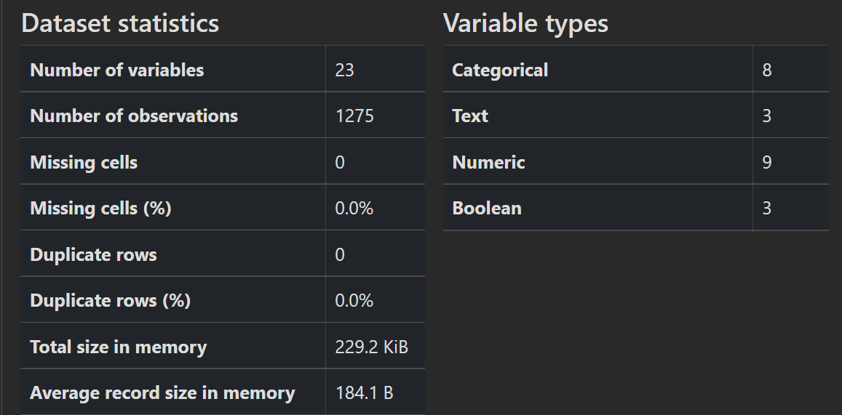
Data Profiling
Performed dataset profiling using ydata-profiling to analyze:
Data quality
Duplicate entries
Outliers
Variable distribution

Slide 8
Exploratory Data Analysis (EDA)
In this step, I explored the dataset to understand the distribution of laptop specifications and pricing patterns.
EDA helped in:
Identifying value frequency (brand, OS, GPU, screen type)
Understanding feature impact on price
Detecting patterns across display, RAM, and GPU
Comparing laptop categories and specifications
Observing premium vs budget laptop segments

Slide 9
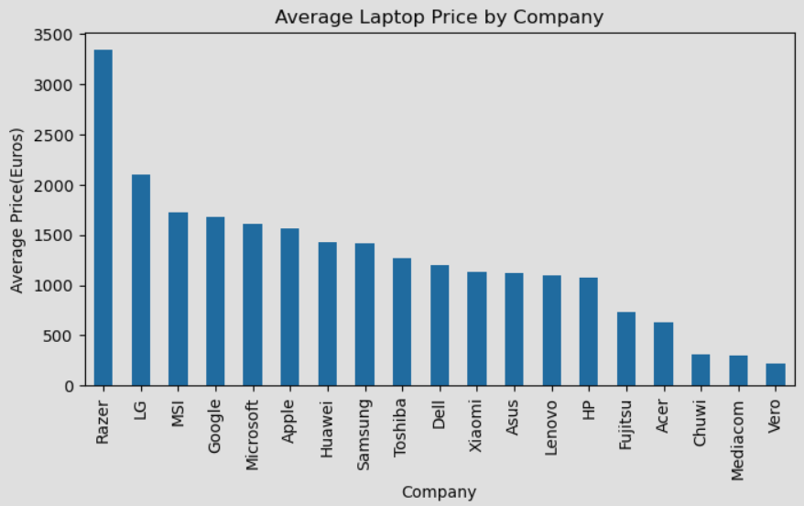
1. Average Laptop Price by Company
Key Insight:
Razer, LG, MSI show highest prices (premium segment).
Dell, Lenovo, HP have wider models but mostly affordable.

Slide 10
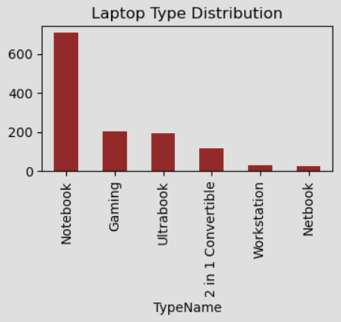
2. Laptop Type Distribution
Key Insight:
Notebooks dominate the market.
Gaming and Ultrabook laptops follow next.
Very few Workstation and Netbook models.

Slide 11
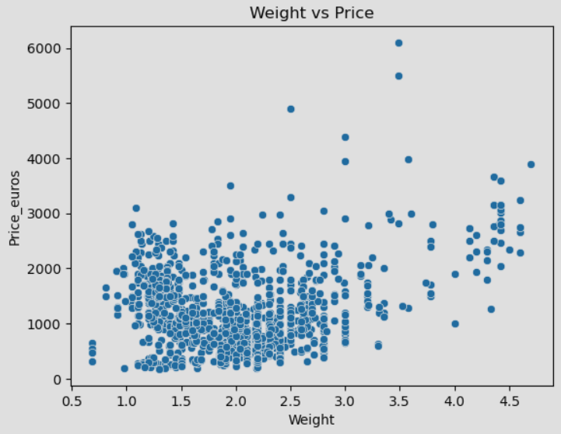
3. Weight vs Price
Key Insight:
No strong correlation between laptop weight and price.
Both light and heavy laptops exist in all price ranges.

Slide 12
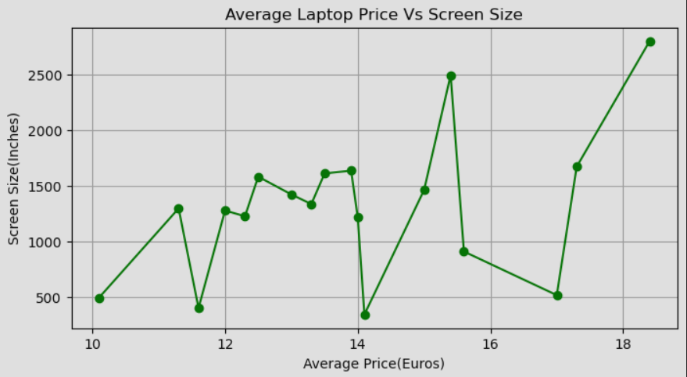
4. Screen Size vs Average Price
Key Insight:
Larger screen laptops (17–19 inches) have higher average price.
Small and medium screens fall in moderate price segment.

Slide 13
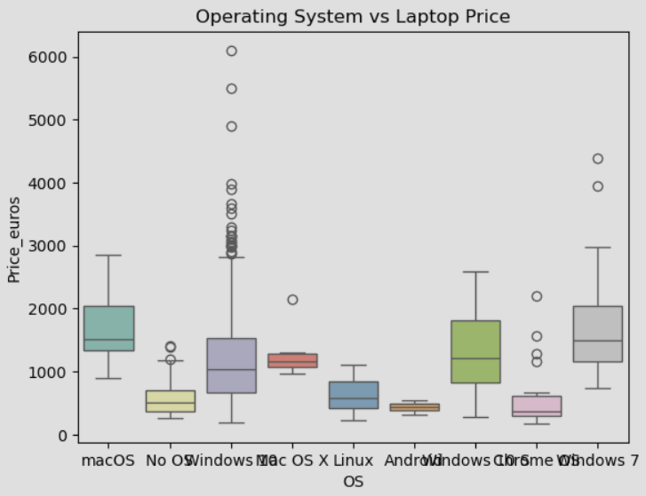
5. Operating System vs Laptop Price
Key Insight:
macOS models have the highest pricing.
Chrome OS & Linux laptops remain budget-friendly.

Slide 14
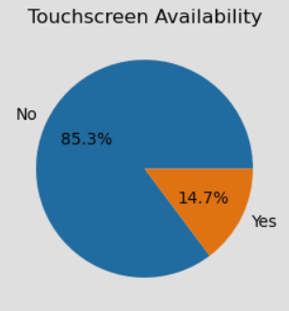
6. Touchscreen Availability
Key Insight:
Only 14.7% laptops include touchscreen.
Majority are non-touchscreen (85.3%).

Slide 15
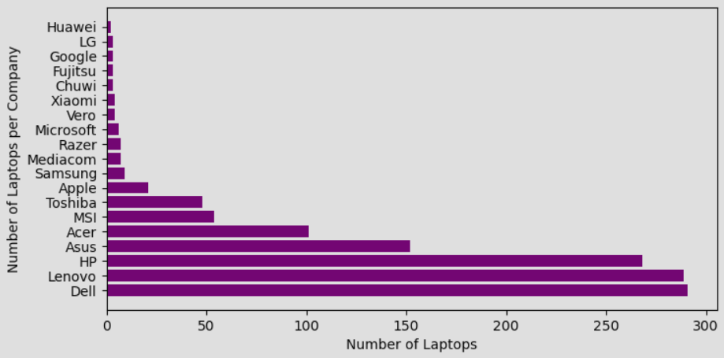
7. Number of Models per Company
Key Insight:
Dell, Lenovo, HP have the highest product count.
Google, LG, Huawei have fewer models.

Slide 16
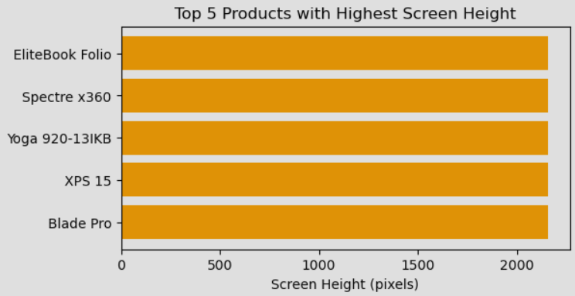
8. Top 5 Laptops – Highest Screen Height
Key Insight:
Models like Spectre x360, EliteBook, Yoga series have highest resolution screens, indicating premium display quality.

Slide 17
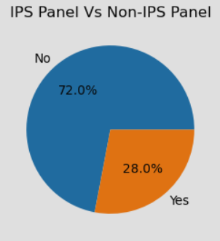
9. IPS Panel Distribution
Key Insight:
Only 28% laptops include IPS display.
72% use non-IPS, meaning IPS is still a premium feature.

Slide 18
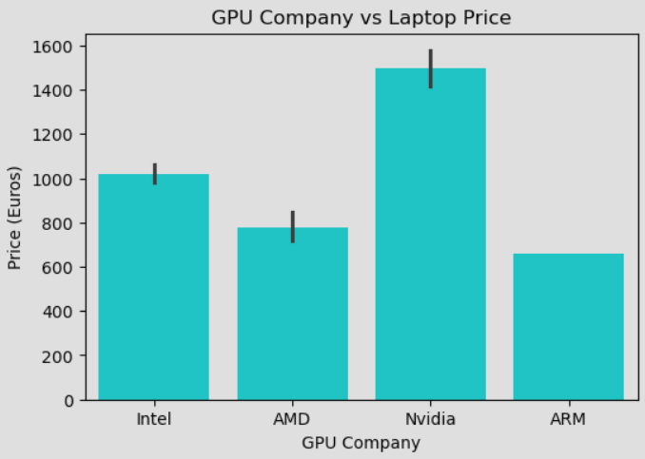
10. GPU vs Price Analysis
Key Insight:
Nvidia laptops are most expensive → high performance category.
ARM & AMD GPUs fall in the lower to mid-range categories.

Slide 19
Overall Insights
Brand & GPU strongly influence laptop pricing.
macOS, IPS, touchscreen, and high-resolution displays increase cost.
Market dominated by Notebook models, followed by Gaming & Ultrabook.

Slide 20
Conclusion
This analysis highlights how various hardware and display features affect laptop pricing.
Premium laptops generally have:
Larger screens
IPS panels
Nvidia GPU
macOS platform
Understanding these specifications helps buyers compare price-value before purchase.

Slide 21
Thank You
Presented By: K.Sathvika

